Slide 1
THE NATURAL RESOURCE CURSE AND HUMAN DEPENDENCE ON BIODIVERSITY
GROUP 9

Slide 2
THE NATURAL RESOURCE CURSE
The resource curse (the paradox of plenty) refers to the failure of many resource-rich countries such as Nigeria and Zambia to benefit fully from their natural resource wealth, and for their governments to respond effectively to public welfare needs.
The phenomenon mainly occurs when a country begins to focus all of its production means on a single industry, such as mining or oil production, and neglects investment in other major sectors.

Slide 3
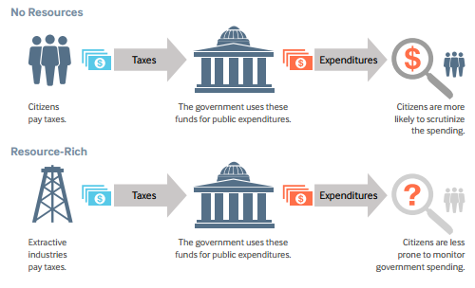
CONTRIBUTORS TO THE NATURAL RESOURCE CURSE
ECONOMIC CONTRIBUTORS:
Volatility of commodity prices
Economic mismanagement

Slide 4
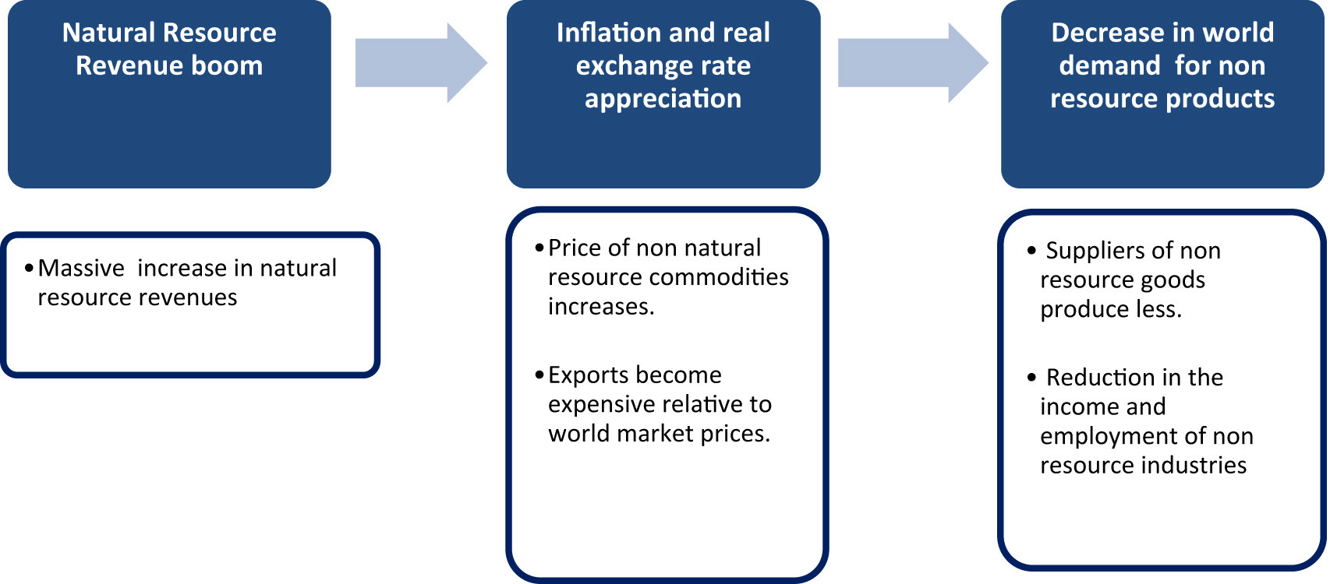
CONTRIBUTORS TO THE NATURAL RESOURCE CURSE
Dutch disease phenomenon;

Slide 5
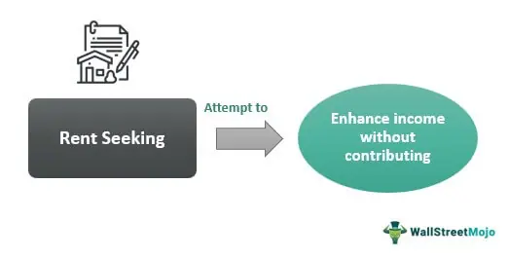
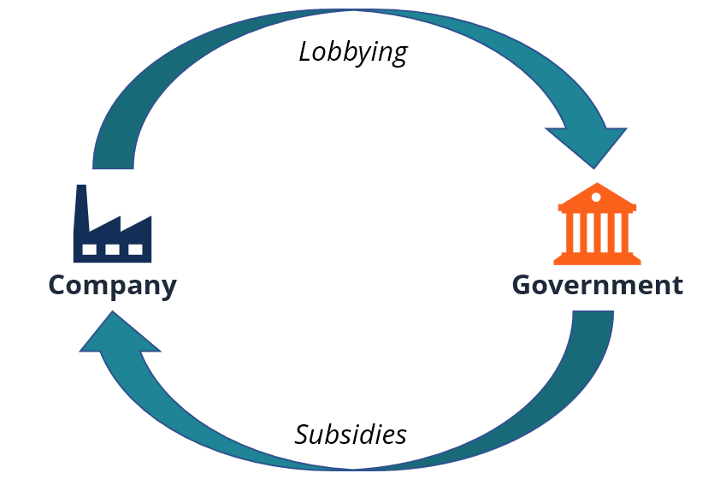
CONTRIBUTORS TO THE NATURAL RESOURCE CURSE
POLITICAL CONTRIBUTORS:
Rent seeking
Corruption and weak institutions

Slide 6
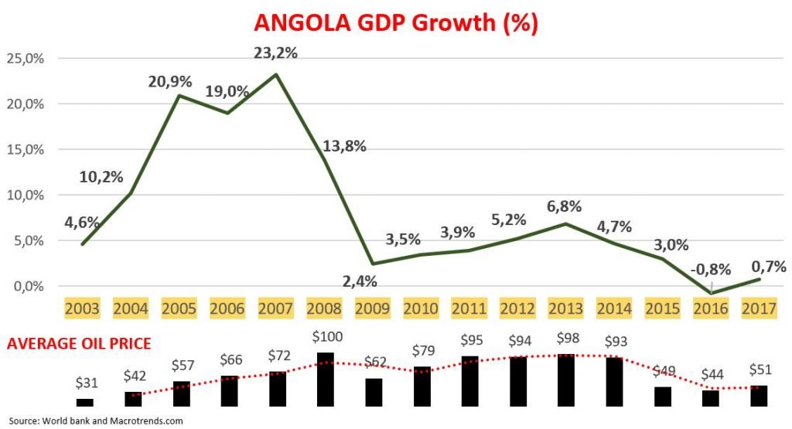
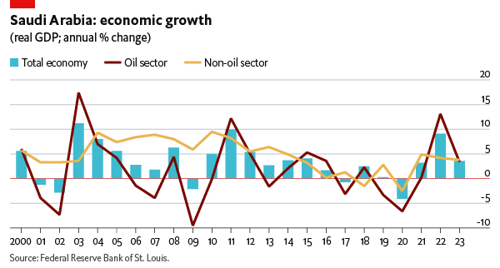
CASE STUDY OF THE RESOURCE CURSE
ANGOLA
SAUDI ARABIA

Slide 7
FEASIBLE SOLUTIONS TO MITIGATE THE CURSE
Policymakers must be aware of these trends and ideologies to help countries understand the risks and opportunities at various decision points in natural resource governance.
Policies should include greater transparency, stabilization and savings funds, diversification of the economy and alternative tax system.

Slide 8

WHAT IS HUMAN DEPENDENCE ON BIODIVERSITY?
Biodiversity forms the web of life that we depend on for so many things such as food, water, medicine, a stable climate, economic growth, among others. We also enjoy other services when the land and ocean absorb more than half of all carbon emissions.

Slide 9
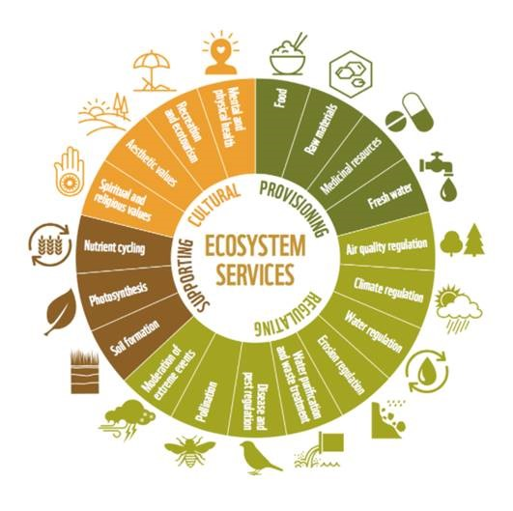
MANIFESTATIONS OF HUMAN DEPENDENCE ON BIODIVERSITY

Slide 10

IMPLICATIONS OF THIS DEPENDENCE
As humans utilise biodiversity, they can promote processes such as fruit and seed dispersal, developing genetic variants of organisms and implementing conservation measures which improve biodiversity.
Adversely, over-exploitation of the provisions of biodiversity cause pollution, habitat destruction and fragmentation, climate change and skyrocketing rates of species extinction.

Slide 11
SUMMARY
In conclusion, the preservation and longevity of the biodiverse environment lies in the hands of mankind. Man must do his part to prudently exploit his resources and protect his support system.

Slide 12

THANK YOU

Slide 13
REFERENCES
Natural Resource Charter (2nd edition, 2014), available at: http://www.resourcegovernance.org/ sites.
Bauer, Andrew, and Juan Carlos Quiroz , Resource Governance in the Handbook of Global Energy Policy (ed. Andreas Goldthau, Wiley-Blackwell, 2013).
Humphreys, M., et al, Introduction in “Escaping the Resource Curse” (Columbia University Press, 2007).

Slide 14
GROUP MEMBERS AND INDEX NUMBERS
Sheila Abrokwa - 9193719
Kofi Abrefah Besea- 9193619
Gyasi Kwabena- 9208719
Esther Frimpong- 9216519
Desmond Sarpong- 9216319
Asante Roland Owusu- 9202019
Alfred Yaw Mireku- 9212719
Audrey Afia Abrafi Appiah- 9200919
Randy Owusu Adansi- 9216819

